Slide 1
Module: 3 Correlation and Regression
Correlation and Regression - Rank Correlation- Partial and Multiple correlation- Multiple regression.

Slide 2
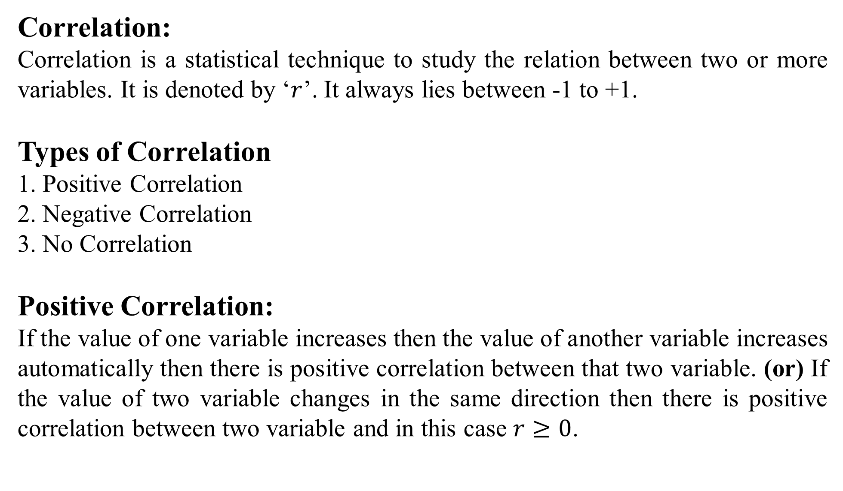
Correlation:
Correlation is a statistical technique to study the relation between two or more variables. It is denoted by ‘$r$’. It always lies between -1 to +1.
Types of Correlation
1. Positive Correlation
2. Negative Correlation
3. No Correlation
Positive Correlation:
If the value of one variable increases then the value of another variable increases automatically then there is positive correlation between that two variable. (or) If the value of two variable changes in the same direction then there is positive correlation between two variable and in this case $r≥0$.

Slide 3
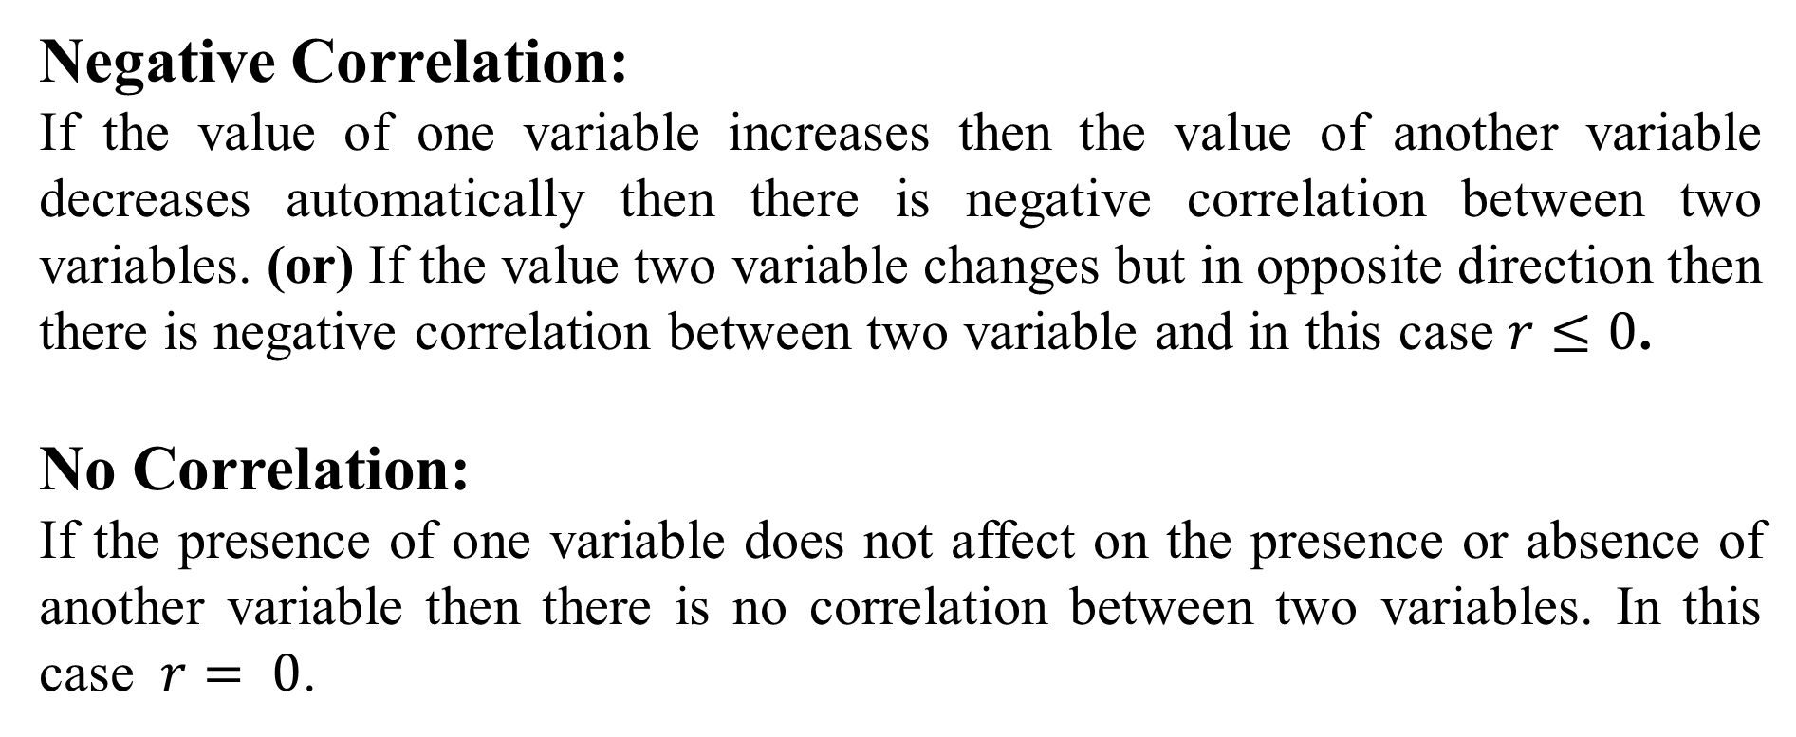
Negative Correlation:
If the value of one variable increases then the value of another variable decreases automatically then there is negative correlation between two variables. (or) If the value two variable changes but in opposite direction then there is negative correlation between two variable and in this case $r≤0$.
No Correlation:
If the presence of one variable does not affect on the presence or absence of another variable then there is no correlation between two variables. In this case $r= 0$.

Slide 4
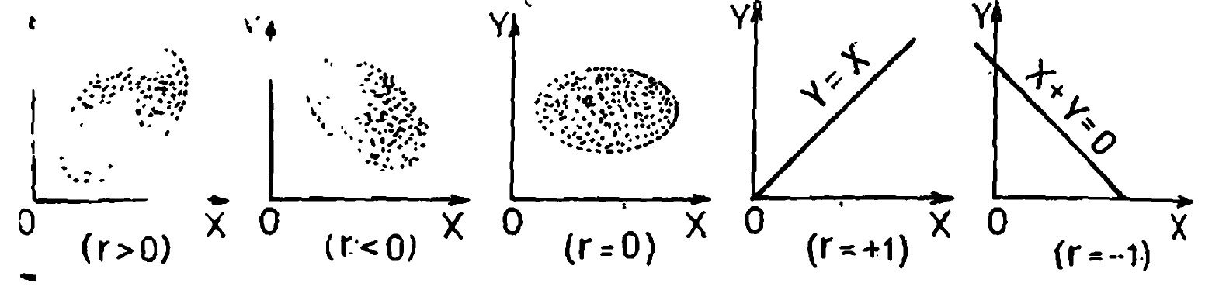
Methods to Study The Correlation:
1. Scatter Diagram
2. Karl Pearson’s Correlation Coefficient (r)
3. Spearman Rank Correlation Coefficient (R)
1. Scatter Diagram

Slide 5
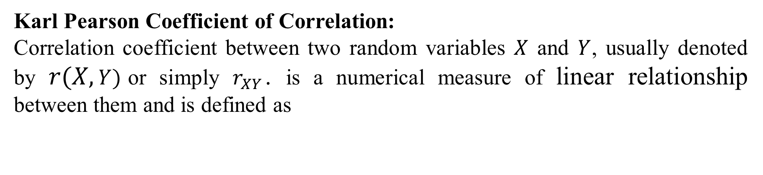
Karl Pearson Coefficient of Correlation:
Correlation coefficient between two random variables $X$ and $Y$, usually denoted by $r(X,Y)$or simply $r_{XY}$. is a numerical measure of linear relationship between them and is defined as

Slide 6
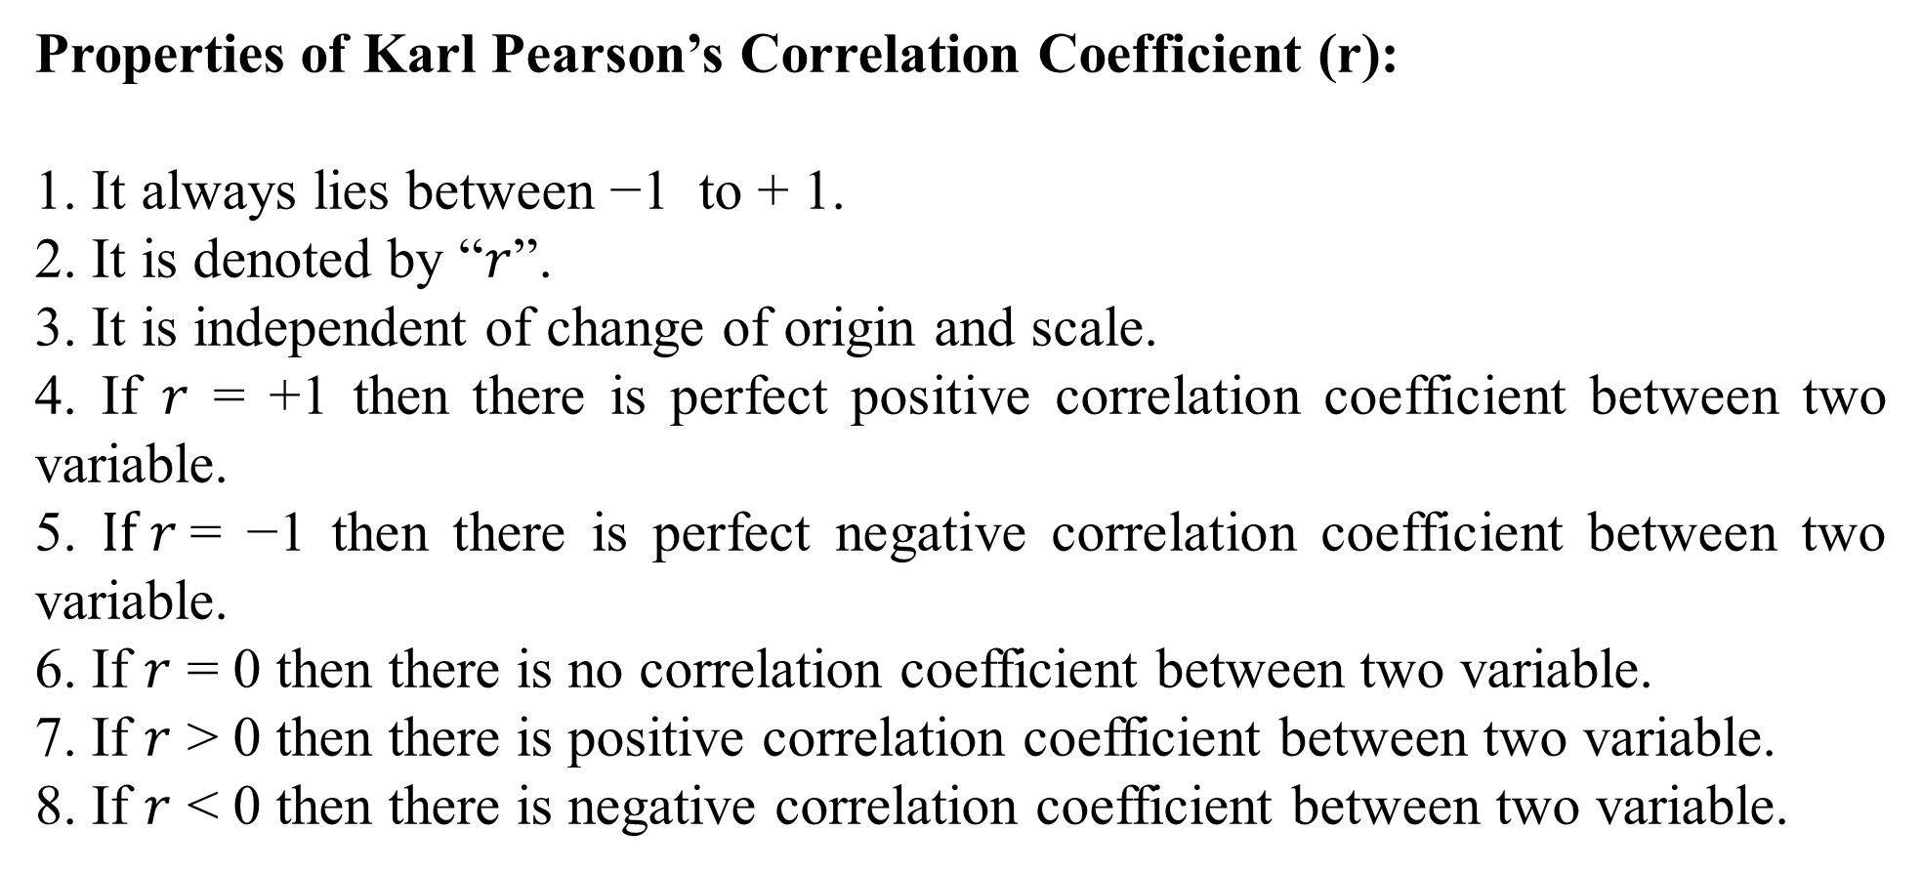
Properties of Karl Pearson’s Correlation Coefficient (r):
1. It always lies between −1 to + 1.
2. It is denoted by “$r$”.
3. It is independent of change of origin and scale.
4. If $r$ = +1 then there is perfect positive correlation coefficient between two variable.
5. $If r$= −1 then there is perfect negative correlation coefficient between two variable.
6. If $r$ = 0 then there is no correlation coefficient between two variable.
7. If $r$ > 0 then there is positive correlation coefficient between two variable.
8. If $r$ < 0 then there is negative correlation coefficient between two variable.

Slide 7
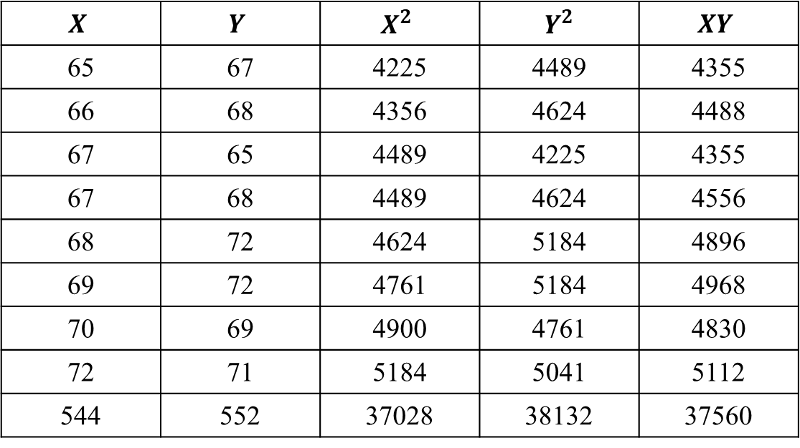
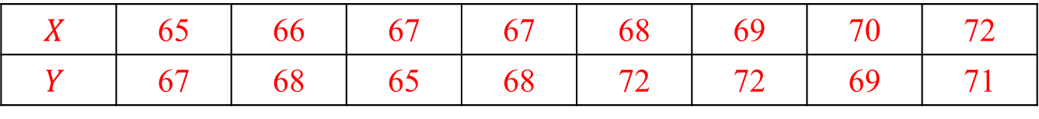
Calculate the correlation coefficient for the following heights (in inches) of fathers (X) and their sons (Y) :
$$X$$ | 65 | 66 | 67 | 67 | 68 | 69 | 70 | 72
$$Y$$ | 67 | 68 | 65 | 68 | 72 | 72 | 69 | 71
Solution:
$$X$$ | $$Y$$ | $$X^{2}$$ | $Y^{2}$ | $$XY$$
65 | 67 | 4225 | 4489 | 4355
66 | 68 | 4356 | 4624 | 4488
67 | 65 | 4489 | 4225 | 4355
67 | 68 | 4489 | 4624 | 4556
68 | 72 | 4624 | 5184 | 4896
69 | 72 | 4761 | 5184 | 4968
70 | 69 | 4900 | 4761 | 4830
72 | 71 | 5184 | 5041 | 5112
544 | 552 | 37028 | 38132 | 37560

Slide 9
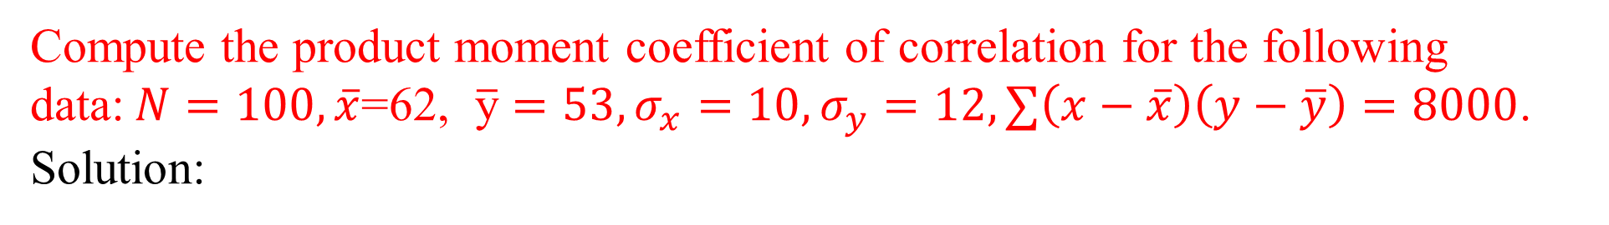
Compute the product moment coefficient of correlation for the following data:$N=100, \overline{x}\text{=62}\text{, }\overline{\text{y}}=53, σ_{x}=10, σ_{y}=12, ∑\left(x−\overline{x}\right)\left(y−\overline{y}\right)=8000$.
Solution:

Slide 10
Spearman Rank Correlation Coefficient (R):
The Psychologist Spearman suggested formula to calculate correlation for qualitative data by considering the ranks,
Calculate Spearman Rank correlation for the following information:
Marks in Mathematics | 67 | 57 | 60 | 76 | 79 | 64 | 73
Marks in Accountancy | 78 | 75 | 66 | 70 | 74 | 72 | 69

Slide 11
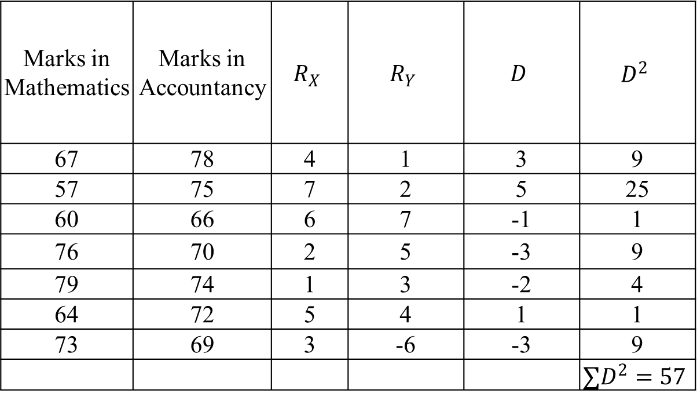
Marks in Mathematics | Marks in Accountancy | $$R_{X}$$ | $$R_{Y}$$ | $$D$$ | $$D^{2}$$
67 | 78 | 4 | 1 | 3 | 9
57 | 75 | 7 | 2 | 5 | 25
60 | 66 | 6 | 7 | -1 | 1
76 | 70 | 2 | 5 | -3 | 9
79 | 74 | 1 | 3 | -2 | 4
64 | 72 | 5 | 4 | 1 | 1
73 | 69 | 3 | -6 | -3 | 9
 |  |  |  |  | $$∑D^{2}=57$$

Slide 12
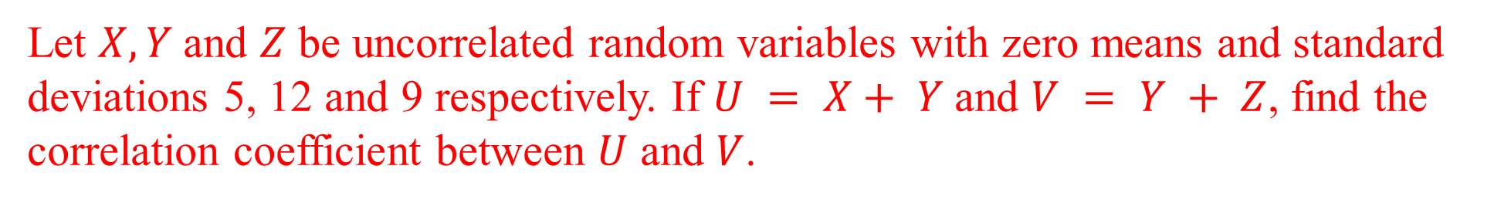
Let $X, Y$and $Z$ be uncorrelated random variables with zero means and standard deviations 5, 12 and 9 respectively. If $U = X+ Y$and $V = Y + Z$, find the correlation coefficient between $U$ and $V$.

Slide 14
If the joint pdf of $(X,Y)$ is given by 𝑓(𝑥, 𝑦) = 𝑥 + 𝑦, 0 ≤ 𝑥, 𝑦 ≤ 1. Find $ρ_{XY}$ .

Slide 16
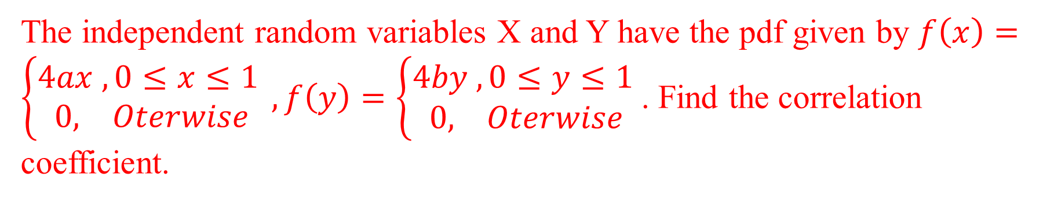
The independent random variables X and Y have the pdf given by $f\left(x\right)=\left\{\begin{aligned}4ax , 0≤x≤1 \\ 0, Oterwise\end{aligned}\right.,f\left(y\right)=\left\{\begin{aligned}4by , 0≤y≤1 \\ 0, Oterwise\end{aligned}\right.$. Find the correlation coefficient.

Slide 17
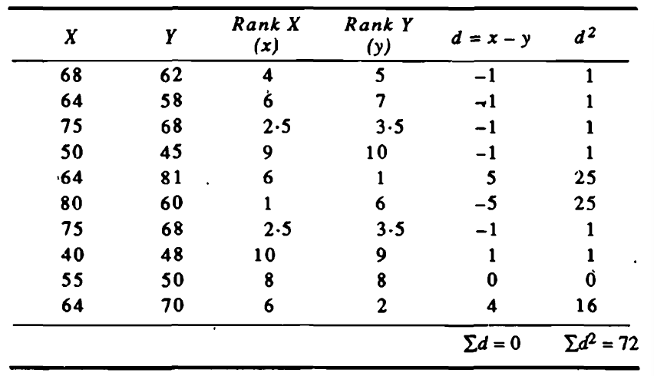
Obtain the rank correlation for the following data

Slide 19
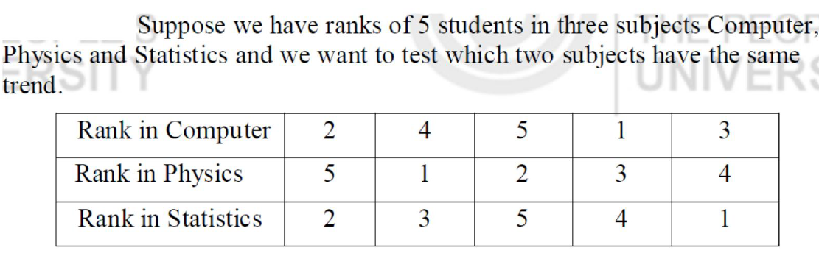
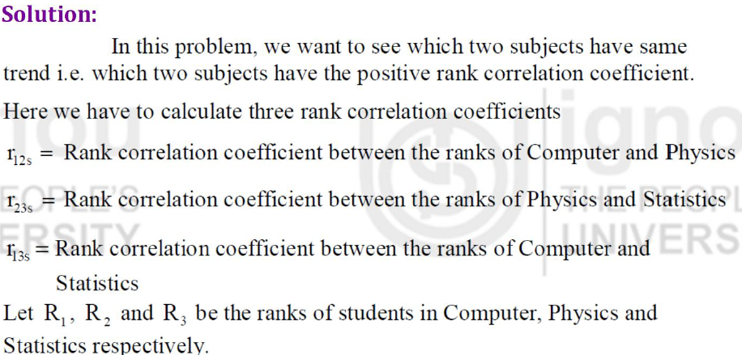

Slide 20
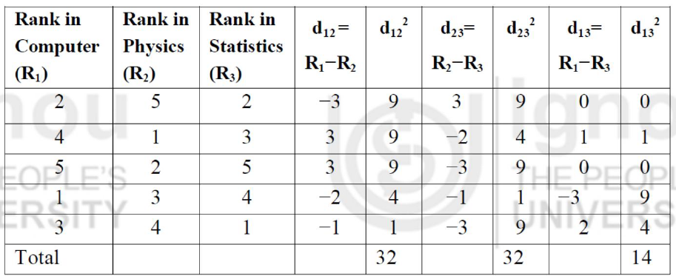

Slide 21
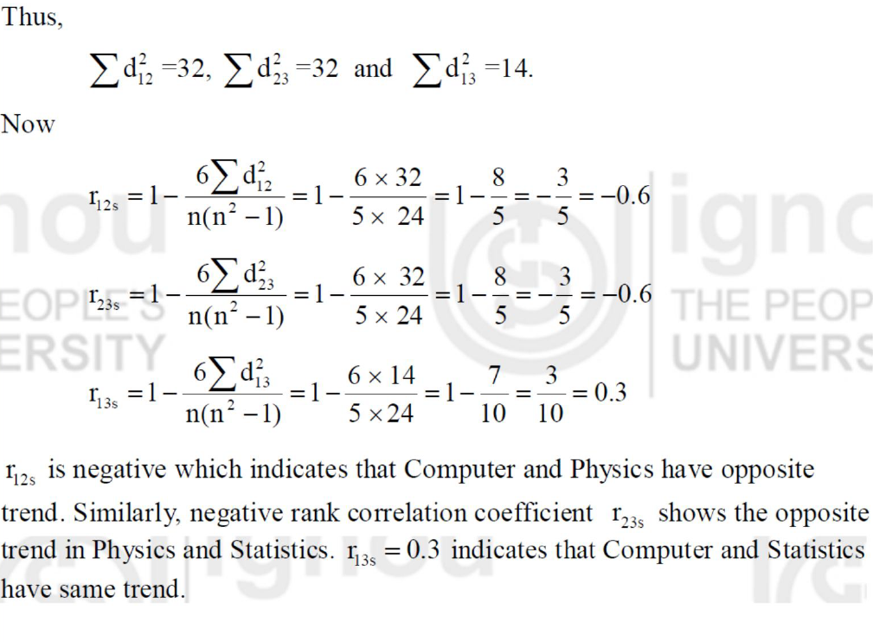

Slide 22
Calculate the Karl pearson’s coefficient of correlation and its probable error between ages of 100 families from the following data:
Ages of Parents in years | Ages of Children's in years
 | 5-10 | 10-15 | 15-20 | 20-25 | 25-30 | Total
15-25 | 6 | 3 | - | - | - | 9
25-35 | 3 | 16 | 10 | - | - | 29
35-45 | - | 10 | 15 | 7 | - | 32
45-55 | - | - | 7 | 10 | 4 | 21
55-65 | - | - | - | 4 | 5 | 9
Total | 9 | 29 | 32 | 21 | 9 | 100

Slide 23
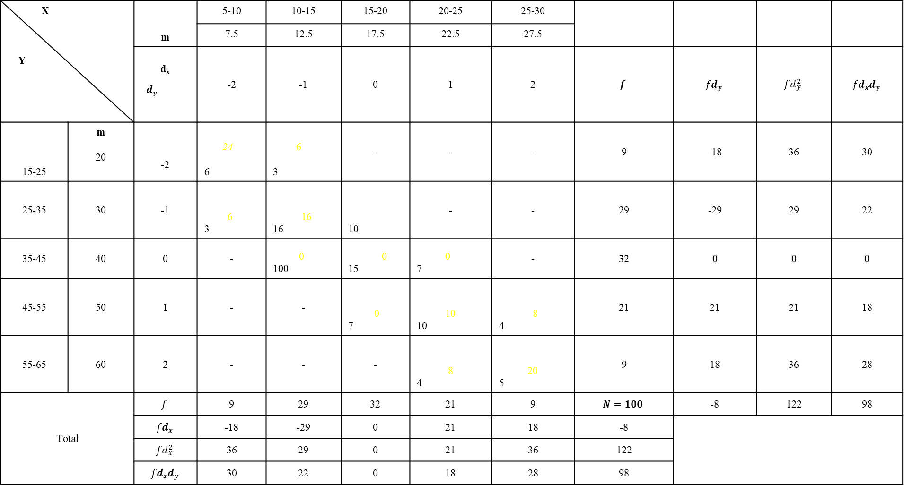
X Y |  | m | 5-10 | 10-15 | 15-20 | 20-25 | 25-30
 |  |  | 7.5 | 12.5 | 17.5 | 22.5 | 27.5
 |  | d_{x} $dy$ | -2 | -1 | 0 | 1 | 2 | $$f$$ | $$fdy$$ | $$fd_{y}^{2}$$ | $$fdxdy$$
15-25 | m 20 | -2 | 24 6 | 6 3 | - | - | - | 9 | -18 | 36 | 30
25-35 | 30 | -1 | 6 3 | 16 16 | 10 | - | - | 29 | -29 | 29 | 22
35-45 | 40 | 0 | - | 0 100 | 0 15 | 0 7 | - | 32 | 0 | 0 | 0
45-55 | 50 | 1 | - | - | 0 7 | 10 10 | 8 4 | 21 | 21 | 21 | 18
55-65 | 60 | 2 | - | - | - | 8 4 | 20 5 | 9 | 18 | 36 | 28
Total |  | $$f$$ | 9 | 29 | 32 | 21 | 9 | $$N=100$$ | -8 | 122 | 98
 |  | $$fdx$$ | -18 | -29 | 0 | 21 | 18 | -8
 |  | $$fd_{x}^{2}$$ | 36 | 29 | 0 | 21 | 36 | 122
 |  | $$fdxdy$$ | 30 | 22 | 0 | 18 | 28 | 98

Slide 24
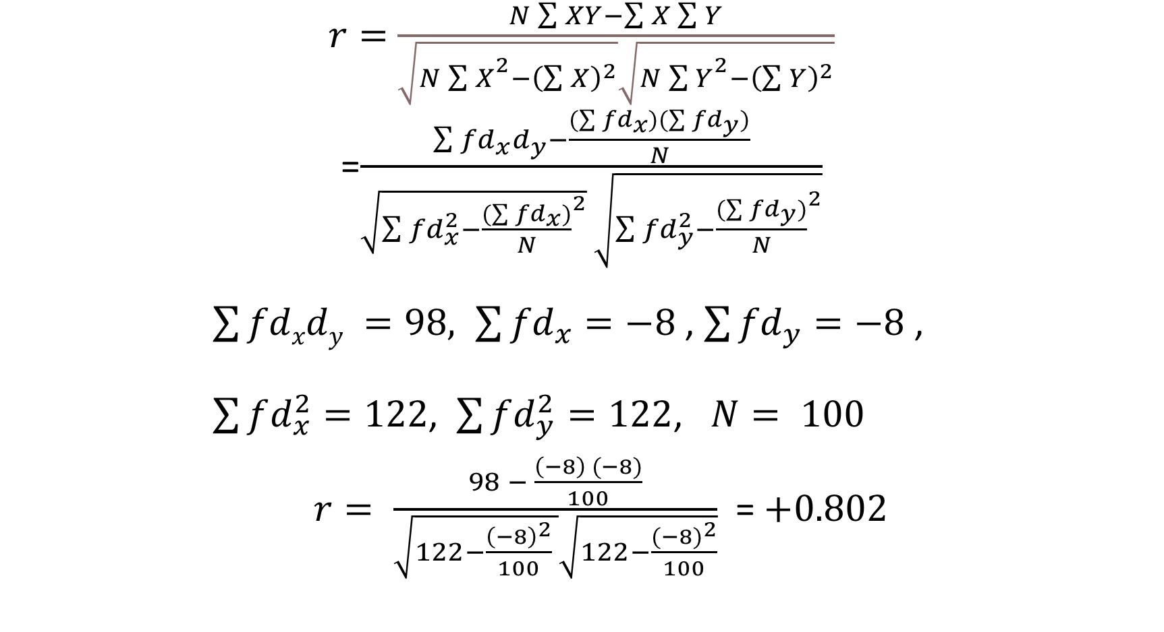
$r=$ $\frac{N\sum{XY−\sum{X\sum{Y}}}}{\sqrt{N{\sum{X}}^{2}−{\left(\sum{X}\right)}^{2}}\sqrt{N{\sum{Y}}^{2}−{\left(\sum{Y}\right)}^{2}}}$
=$\frac{\sum{{fd}_{x}d_{y}−\frac{(\sum{{fd}_{x})(\sum{{fd}_{y}})}}{N}}}{\sqrt{{\sum{{fd}_{x}^{2}−\frac{(\sum{{fd}_{x}})}{N}}}^{2}} \sqrt{{\sum{{fd}_{y}^{2}−\frac{(\sum{{fd}_{y}})}{N}}}^{2}}}$
$\sum{fdxdy }=98, \sum{{fd}_{x}=−8 }$, $\sum{{fd}_{y}}=−8$ ,
$\sum{fd_{x}^{2}}=122$, $\sum{fd_{y}^{2}}=122$, $N= 100$
$r= \frac{98 − \frac{\left(−8\right) (−8)}{100}}{\sqrt{122−\frac{{\left(−8\right)}^{2}}{100} }\sqrt{122−\frac{{(−8)}^{2}}{100}}}$ = $+0.802$

Slide 25
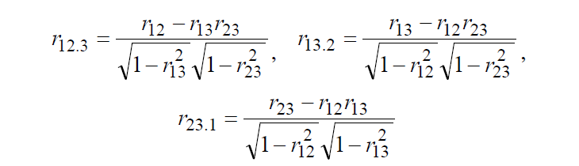
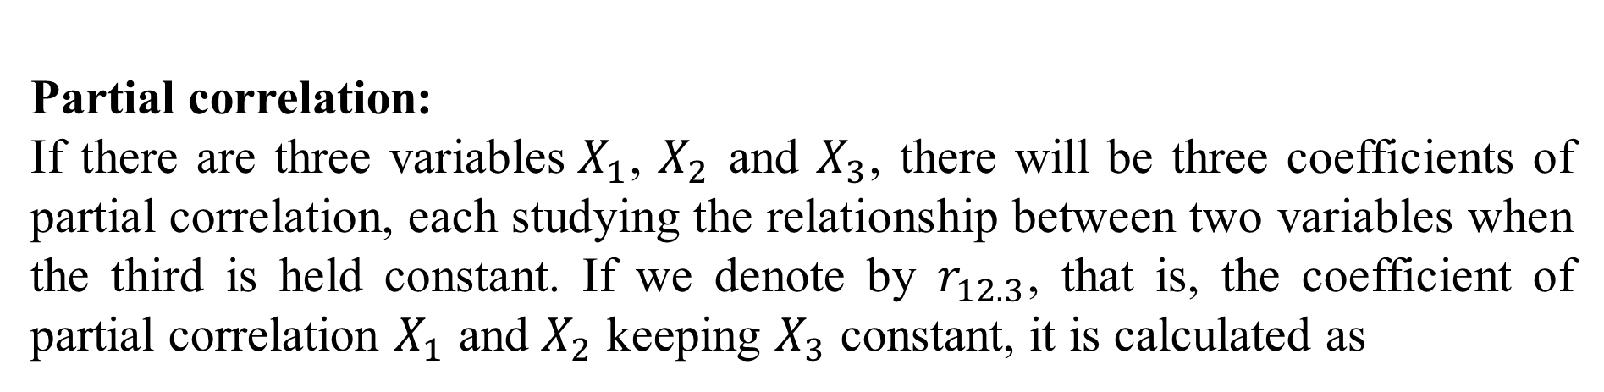
Partial correlation:
If there are three variables$X_{1}$, $X_{2}$ and $X_{3}$, there will be three coefficients of partial correlation, each studying the relationship between two variables when the third is held constant. If we denote by $r_{12.3}$, that is, the coefficient of partial correlation $X_{1}$ and $X_{2}$ keeping $X_{3}$ constant, it is calculated as

Slide 26

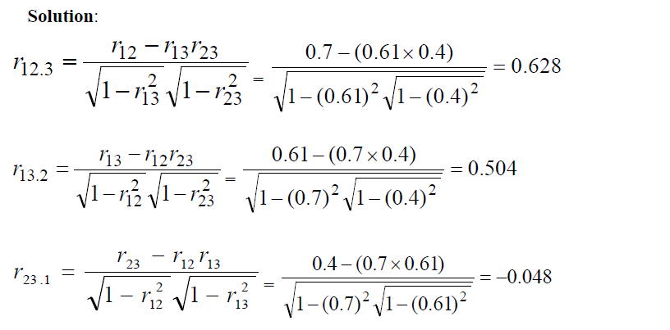

Slide 27
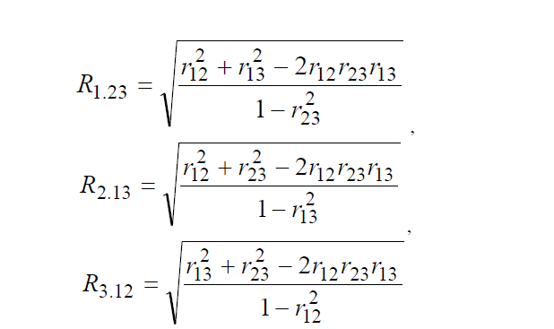
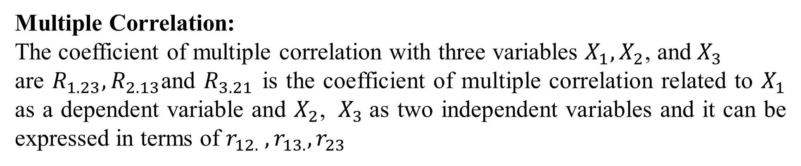
Multiple Correlation:
The coefficient of multiple correlation with three variables $X_{1},X_{2}$, ${\text{and} X}_{3}$
are $R_{1.23}, R_{2.13}$and $R_{3.21}$ is the coefficient of multiple correlation related to $X_{1}$ as a dependent variable and $X_{2}$, ${ X}_{3}$as two independent variables and it can be expressed in terms of $r_{12.} ,r_{13.},r_{23}$

Slide 28
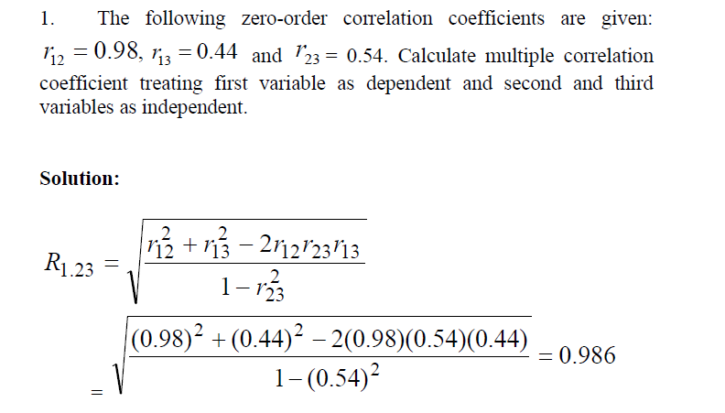

Slide 29
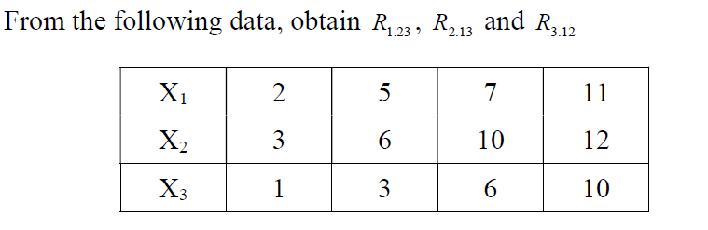
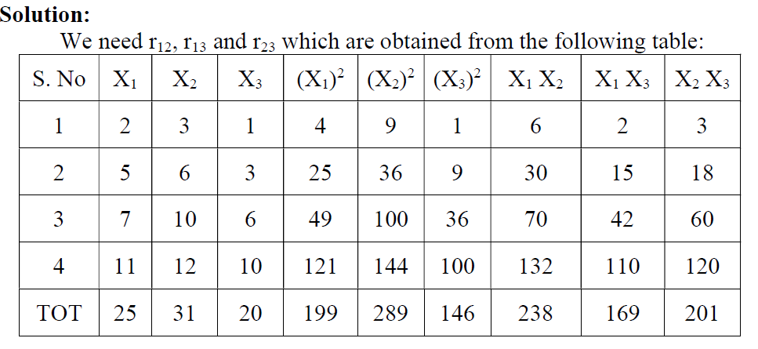

Slide 32
Regression Analysis
The statistical tool with the help of which we are in a position to estimate (or predict) the unknown values of one variable from known values of another variable is called regression.

Slide 33
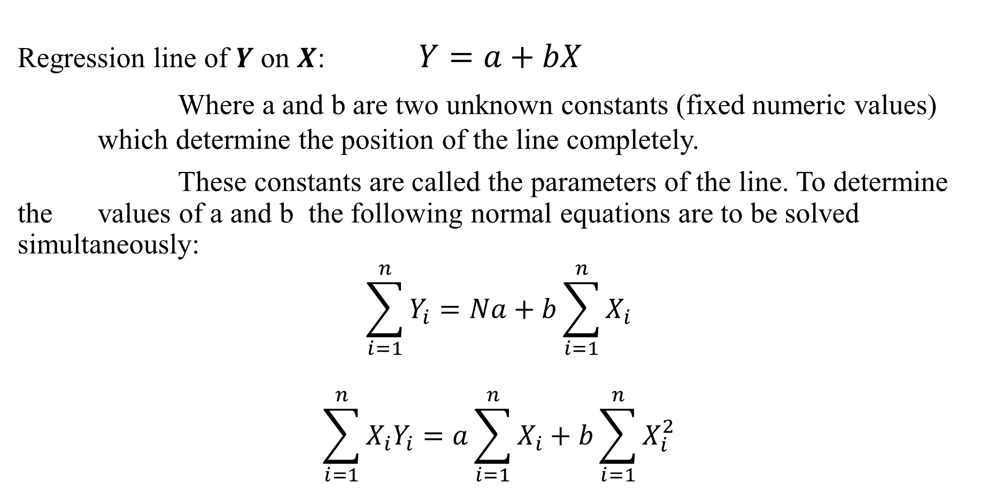
Regression Lines:
Regression line of $Y$ on $X$: $Y=a+bX$
Where a and b are two unknown constants (fixed numeric values) which determine the position of the line completely.
These constants are called the parameters of the line. To determine the values of a and b the following normal equations are to be solved simultaneously:
$$\sum_{i=1}^{n}{Y_{i}}=Na+b\sum_{i=1}^{n}{X_{i}}$$
$$\sum_{i=1}^{n}{X_{i}Y_{i}}=a\sum_{i=1}^{n}{X_{i}}+b\sum_{i=1}^{n}{X_{i}^{2}}$$

Slide 34
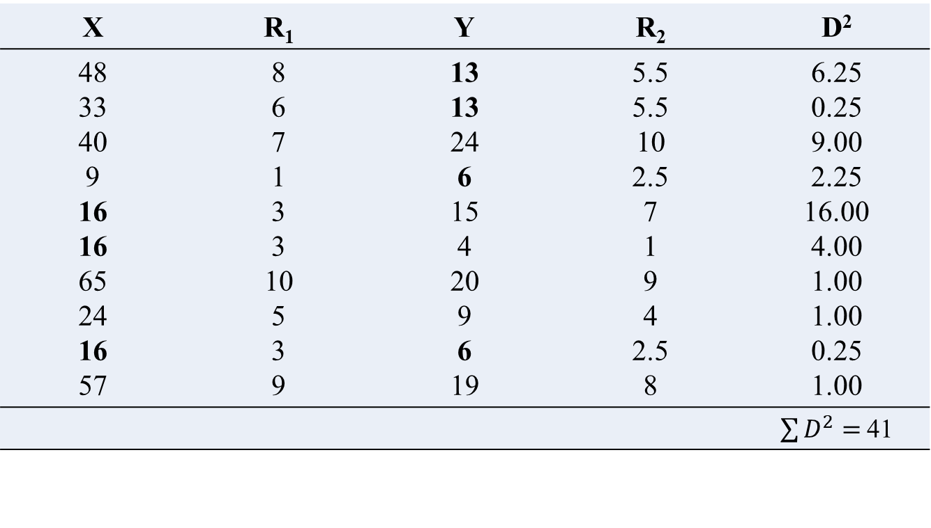
Regression line of $X$on $Y$:
$X=a+bY$
The normal equations to solve the parameters are:
$$\sum_{i=1}^{n}{X_{i}}=Na+b\sum_{i=1}^{n}{Y_{i}}$$
$$\sum_{i=1}^{n}{X_{i}Y_{i}}=a\sum_{i=1}^{n}{Y_{i}}+b\sum_{i=1}^{n}{Y_{i}^{2}}$$

Slide 35
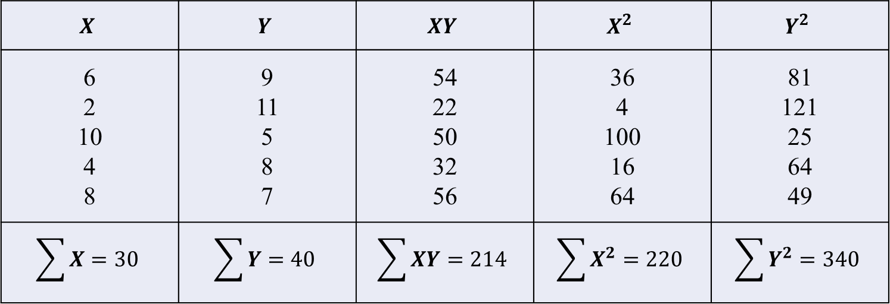
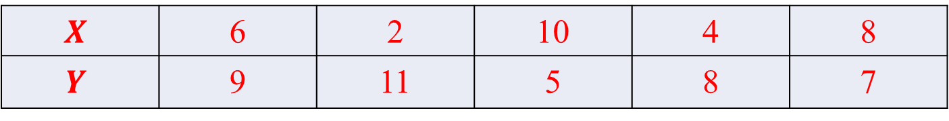
From the following data obtain the two regression lines by normal equation:
$$X$$ | 6 | 2 | 10 | 4 | 8
$$Y$$ | 9 | 11 | 5 | 8 | 7
$$X$$ | $$Y$$ | $$XY$$ | $$X^{2}$$ | $$Y^{2}$$
6 2 10 4 8 | 9 11 5 8 7 | 54 22 50 32 56 | 36 4 100 16 64 | 81 121 25 64 49
$$\sum{X}=30$$ | $$\sum{Y}=40$$ | $$\sum{XY}=214$$ | $$\sum{X^{2}}=220$$ | $$\sum{Y^{2}}=340$$

Slide 36
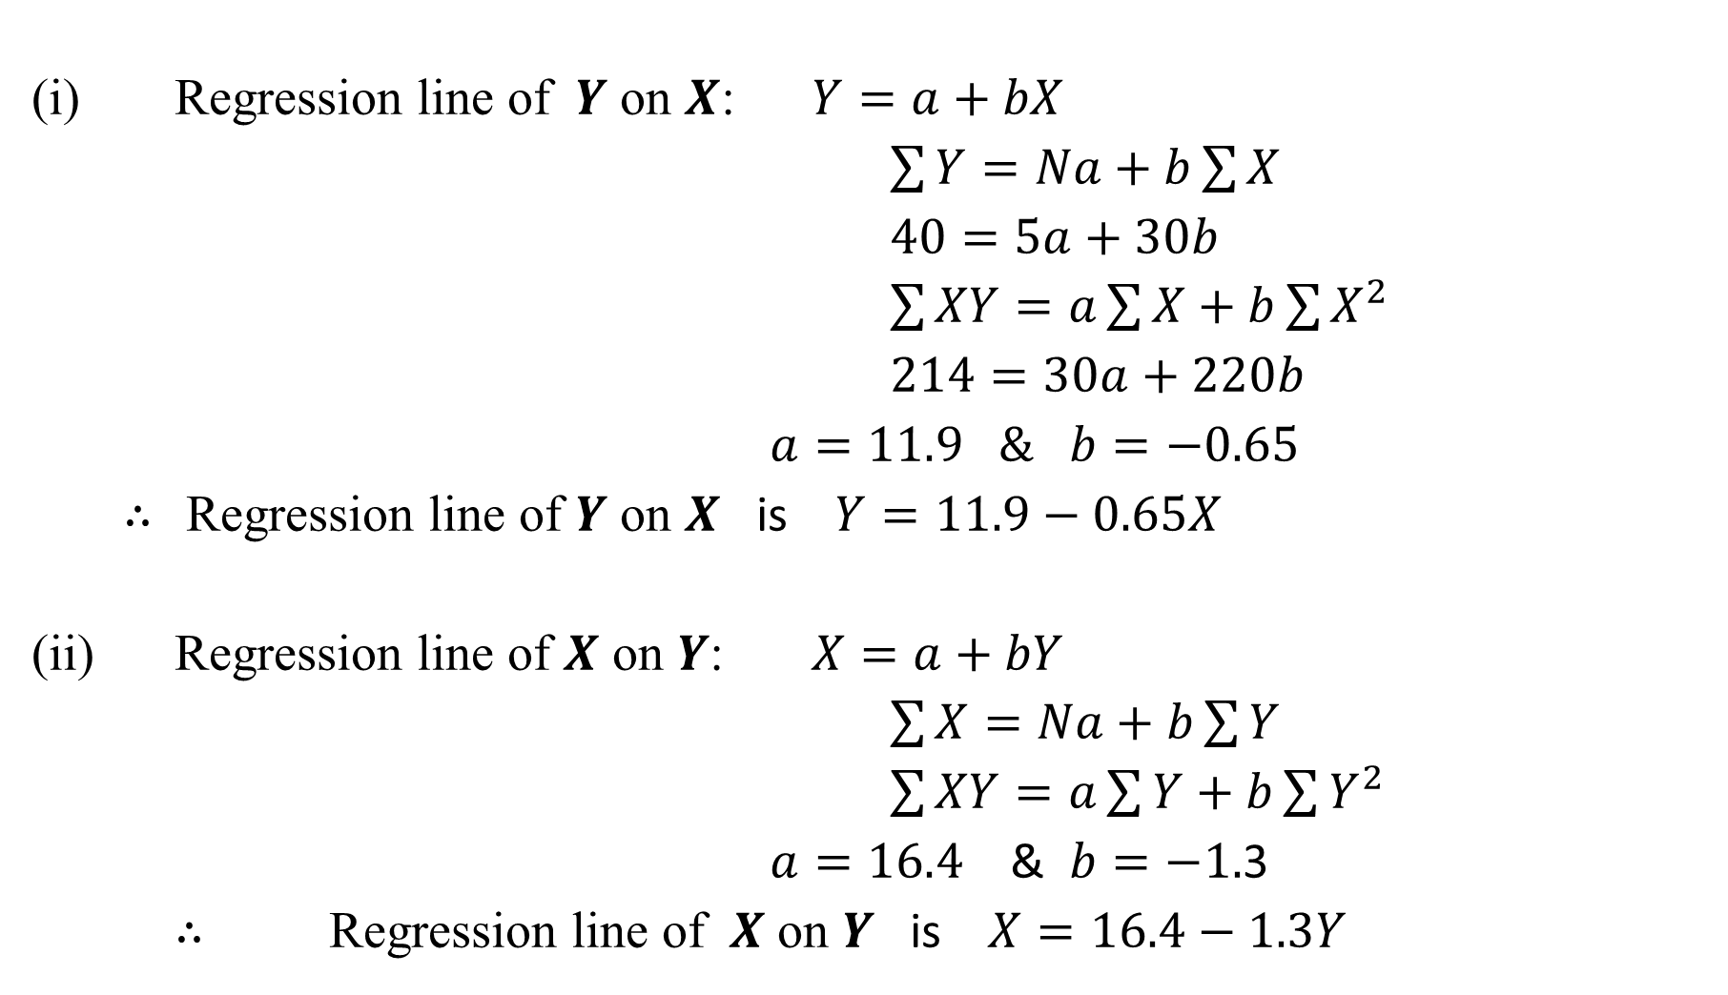
(i) Regression line of $Y$ on $X$: $Y=a+bX$
$\sum{Y=Na+b\sum{X}}$
$40=5a+30b$
$\sum{XY=a\sum{X}+b\sum{X^{2}}}$
$214=30a+220b$
$a=11.9$ $\&$ $b=−0.65$
$∴$ Regression line of $Y$ on $X$ is $Y=11.9−0.65X$
(ii) Regression line of $X$ on $Y$: $X=a+bY$
$\sum{X=Na+b\sum{Y}}$
$\sum{XY=a\sum{Y}+b\sum{Y^{2}}}$
$a=16.4$ & $b=−1.$3
$∴$ Regression line of $X$ on $Y$ is $X=16.4−1.3Y$

Slide 37
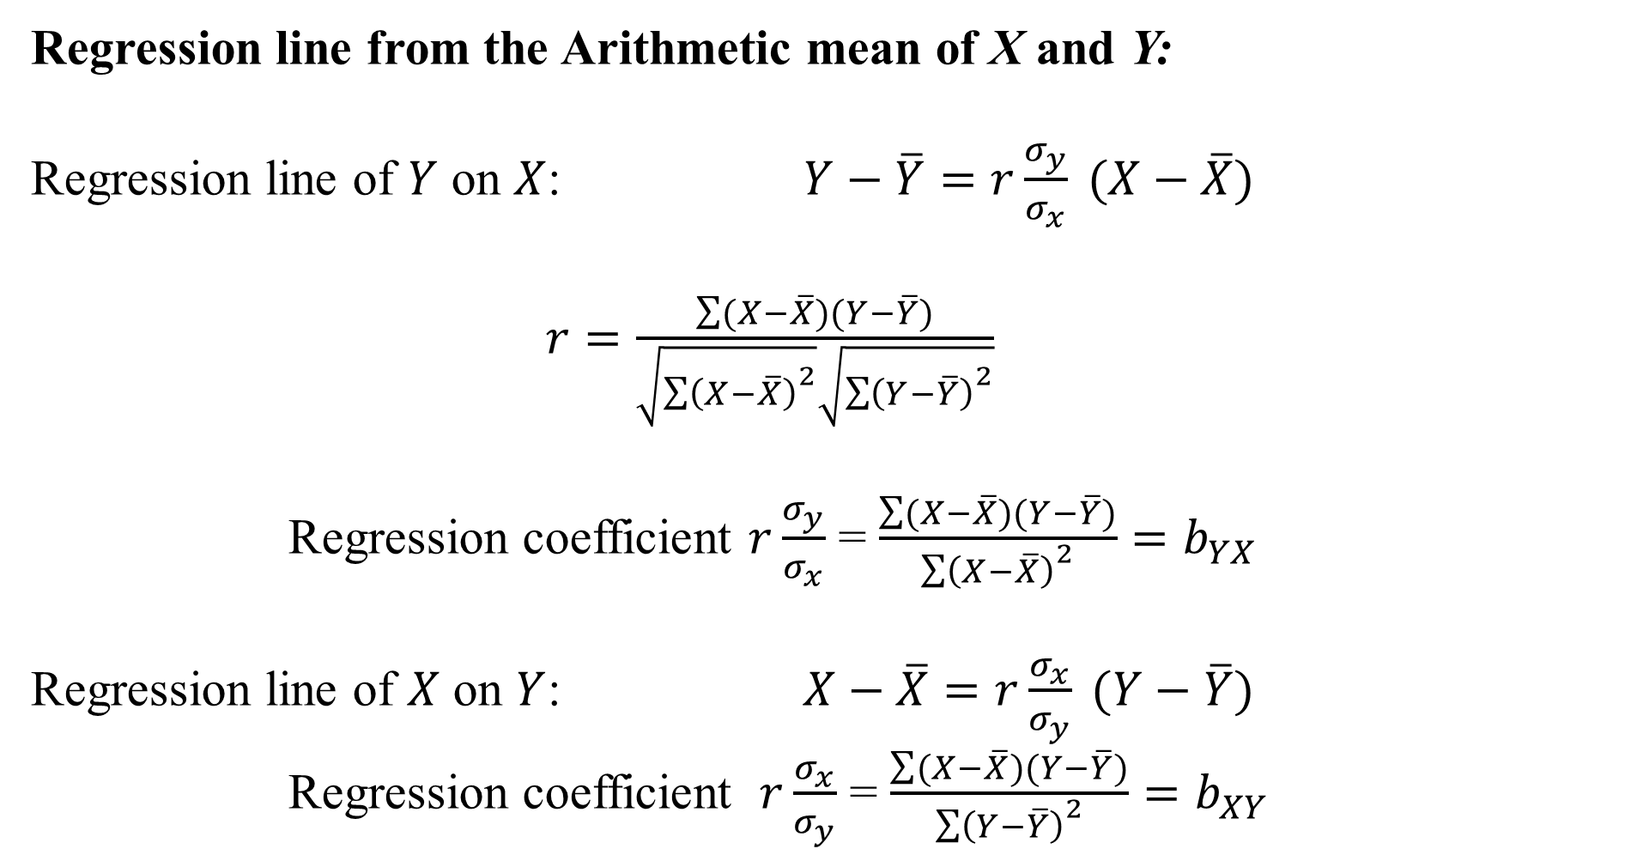
Regression line from the Arithmetic mean of X and Y:
Regression line of $Y$ on $X$: $Y−\overline{Y}=r\frac{σ_{y}}{σ_{x}} (X−\overline{X})$
$r=\frac{\sum{(X−\overline{X})(Y−\overline{Y})}}{\sqrt{{\sum{\left(X−\overline{X}\right)}}^{2}}\sqrt{{\sum{\left(Y−\overline{Y}\right)}}^{2}}}$
Regression coefficient $r\frac{σ_{y}}{σ_{x}}$ = $\frac{\sum{(X−\overline{X})(Y−\overline{Y})}}{{\sum{\left(X−\overline{X}\right)}}^{2}}=b_{YX}$
Regression line of $X$ on $Y$: $X−\overline{X}=r\frac{σ_{x}}{σ_{y}} (Y−\overline{Y})$
Regression coefficient $r\frac{σ_{x}}{σ_{y}}$ = $\frac{\sum{(X−\overline{X})(Y−\overline{Y})}}{{\sum{\left(Y−\overline{Y}\right)}}^{2}}=b_{XY}$

Slide 38
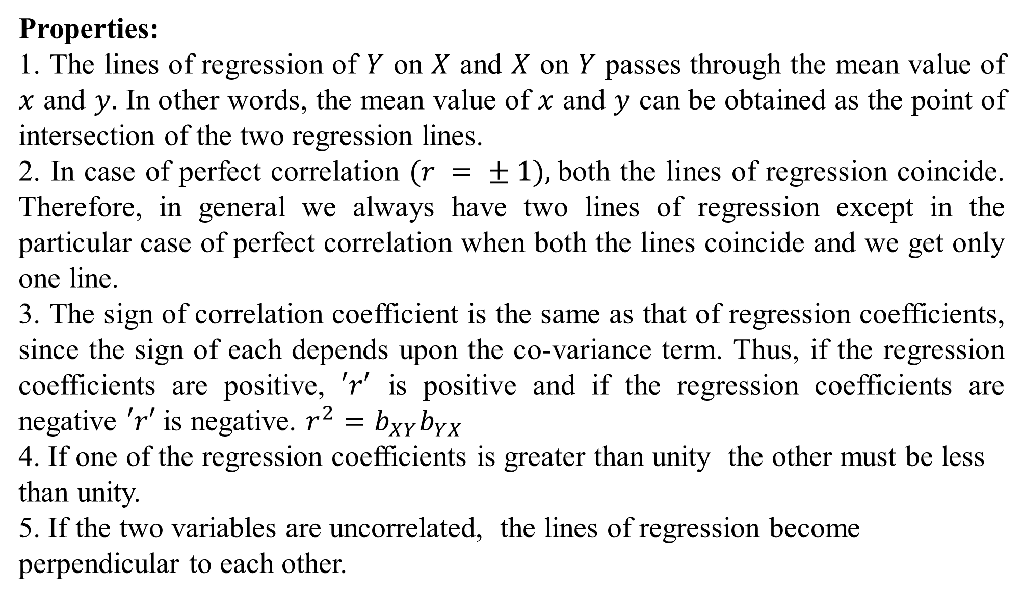
Properties:
1. The lines of regression of $Y$ on $X$ and $X$ on $Y$ passes through the mean value of $x$ and $y.$ In other words, the mean value of $x$ and $y$ can be obtained as the point of intersection of the two regression lines.
2. In case of perfect correlation $(r = ± 1),$both the lines of regression coincide. Therefore, in general we always have two lines of regression except in the particular case of perfect correlation when both the lines coincide and we get only one line.
3. The sign of correlation coefficient is the same as that of regression coefficients, since the sign of each depends upon the co-variance term. Thus, if the regression coefficients are positive, $′r′$ is positive and if the regression coefficients are negative $′r′$ is negative. $r^{2}=b_{XY}b_{YX}$
4. If one of the regression coefficients is greater than unity the other must be less than unity.
5. If the two variables are uncorrelated, the lines of regression become perpendicular to each other.

Slide 39
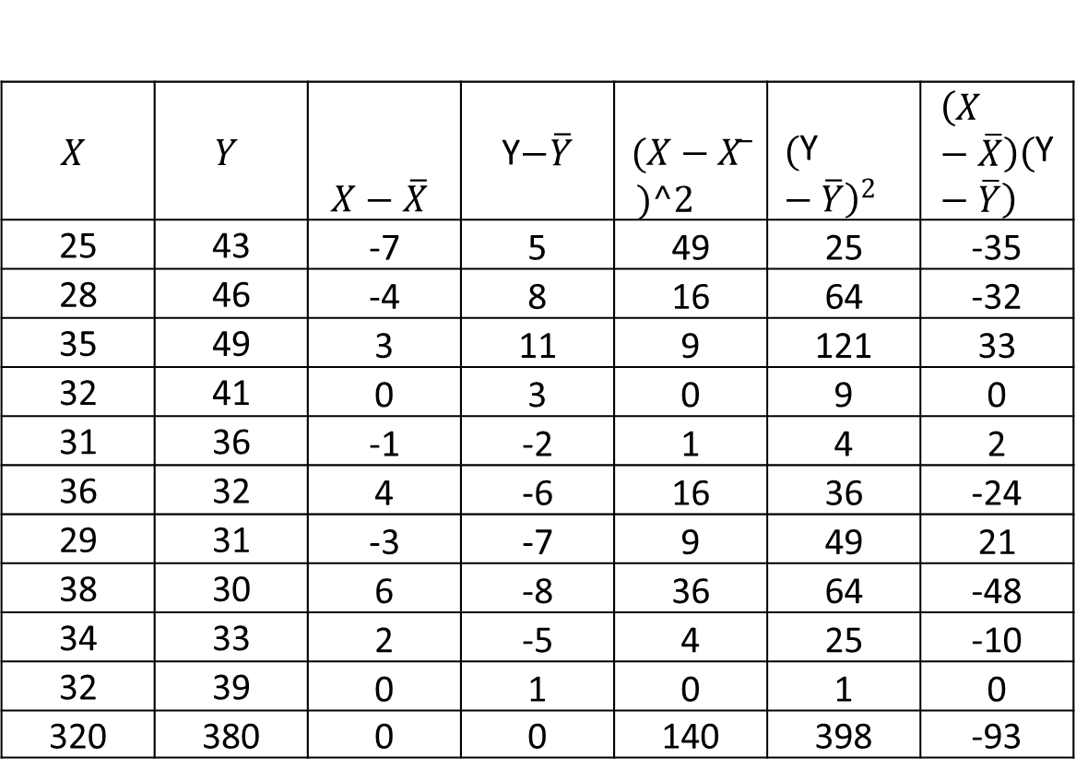
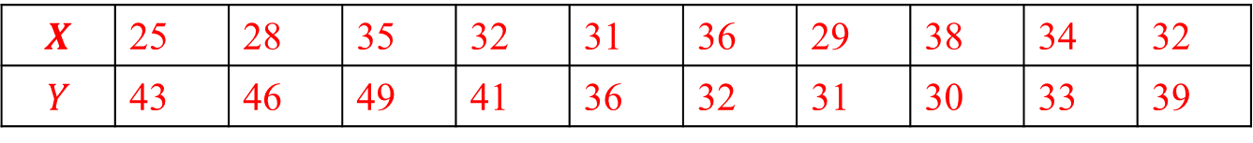
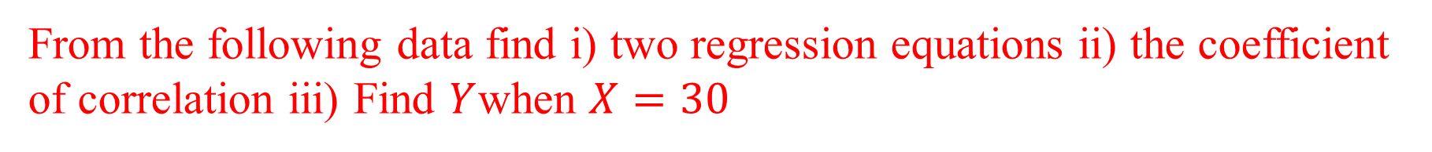
From the following data find i) two regression equations ii) the coefficient of correlation iii) Find $Y$when $X=30$
$$X$$ | 25 | 28 | 35 | 32 | 31 | 36 | 29 | 38 | 34 | 32
$$Y$$ | 43 | 46 | 49 | 41 | 36 | 32 | 31 | 30 | 33 | 39
$$X$$ | $$Y$$ | $$X−\overline{X}$$ | Y$−\overline{Y}$ | $$(X−X ̅$$ $$)^2$$ | $${\left(\text{Y}−\overline{Y}\right)}^{2}$$ | $$\left(X−\overline{X}\right)\left(\text{Y}−\overline{Y}\right)$$
25 | 43 | -7 | 5 | 49 | 25 | -35
28 | 46 | -4 | 8 | 16 | 64 | -32
35 | 49 | 3 | 11 | 9 | 121 | 33
32 | 41 | 0 | 3 | 0 | 9 | 0
31 | 36 | -1 | -2 | 1 | 4 | 2
36 | 32 | 4 | -6 | 16 | 36 | -24
29 | 31 | -3 | -7 | 9 | 49 | 21
38 | 30 | 6 | -8 | 36 | 64 | -48
34 | 33 | 2 | -5 | 4 | 25 | -10
32 | 39 | 0 | 1 | 0 | 1 | 0
320 | 380 | 0 | 0 | 140 | 398 | -93

Slide 42
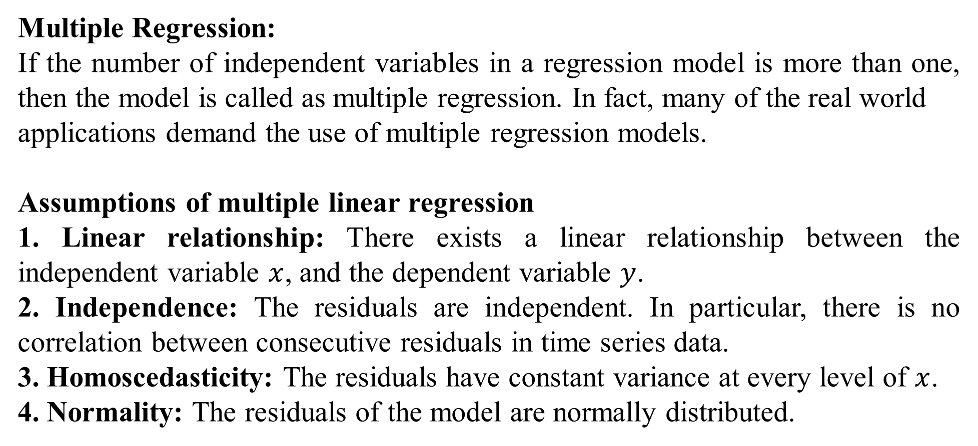
Multiple Regression:
If the number of independent variables in a regression model is more than one, then the model is called as multiple regression. In fact, many of the real world
applications demand the use of multiple regression models.
Assumptions of multiple linear regression
1. Linear relationship: There exists a linear relationship between the independent variable $x$, and the dependent variable $y$.
2. Independence: The residuals are independent. In particular, there is no correlation between consecutive residuals in time series data.
3. Homoscedasticity: The residuals have constant variance at every level of $x$.
4. Normality: The residuals of the model are normally distributed.

Slide 43
Multiple linear Regression formula:
Regression model with two independent variables using normal equations:

Slide 44
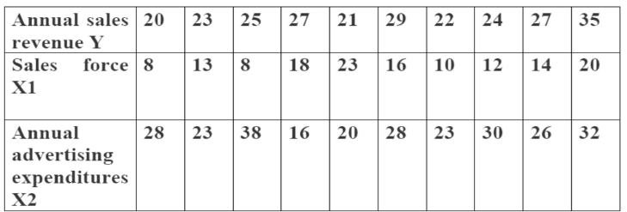
The annual sales revenue (in crores of rupees) of a product as a function of sales force (number of salesmen) and annual advertising expenditure (in lakhs of rupees) for the past 10 years are summarized in the following table.

Slide 45
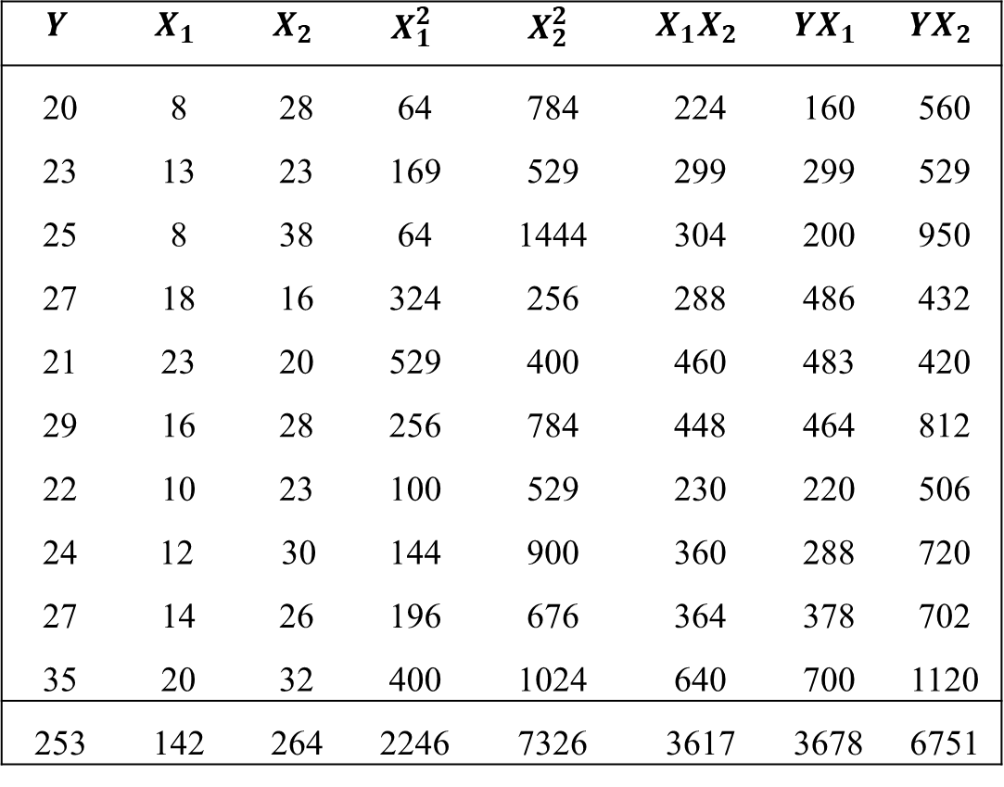
$$Y$$ | $$X_{1}$$ | $$X_{2}$$ | $$X_{1}^{2}$$ | $$X_{2}^{2}$$ | $$X_{1}X_{2}$$ | $$YX_{1}$$ | $$YX_{2}$$
20 | 8 | 28 | 64 | 784 | 224 | 160 | 560
23 | 13 | 23 | 169 | 529 | 299 | 299 | 529
25 | 8 | 38 | 64 | 1444 | 304 | 200 | 950
27 | 18 | 16 | 324 | 256 | 288 | 486 | 432
21 | 23 | 20 | 529 | 400 | 460 | 483 | 420
29 | 16 | 28 | 256 | 784 | 448 | 464 | 812
22 | 10 | 23 | 100 | 529 | 230 | 220 | 506
24 | 12 30 |  | 144 | 900 | 360 | 288 | 720
27 | 14 | 26 | 196 | 676 | 364 | 378 | 702
35 | 20 | 32 | 400 | 1024 | 640 | 700 | 1120
253 | 142 | 264 | 2246 | 7326 | 3617 | 3678 | 6751

Slide 46
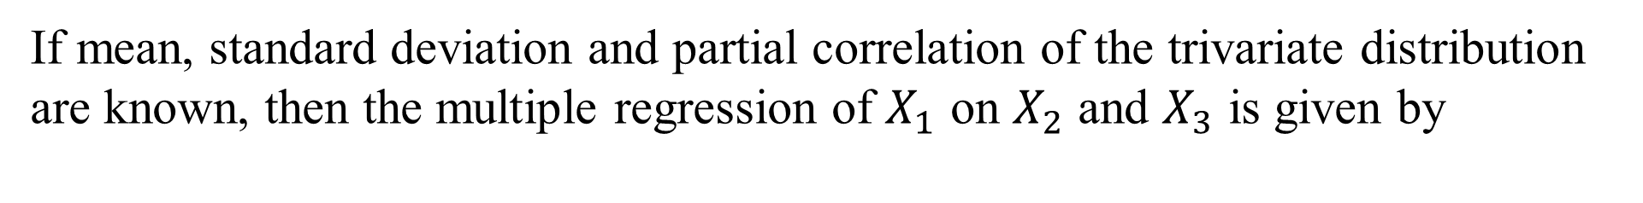
If mean, standard deviation and partial correlation of the trivariate distribution are known, then the multiple regression of $X_{1}$ on $X_{2}$ and $X_{3}$ is given by

Slide 47
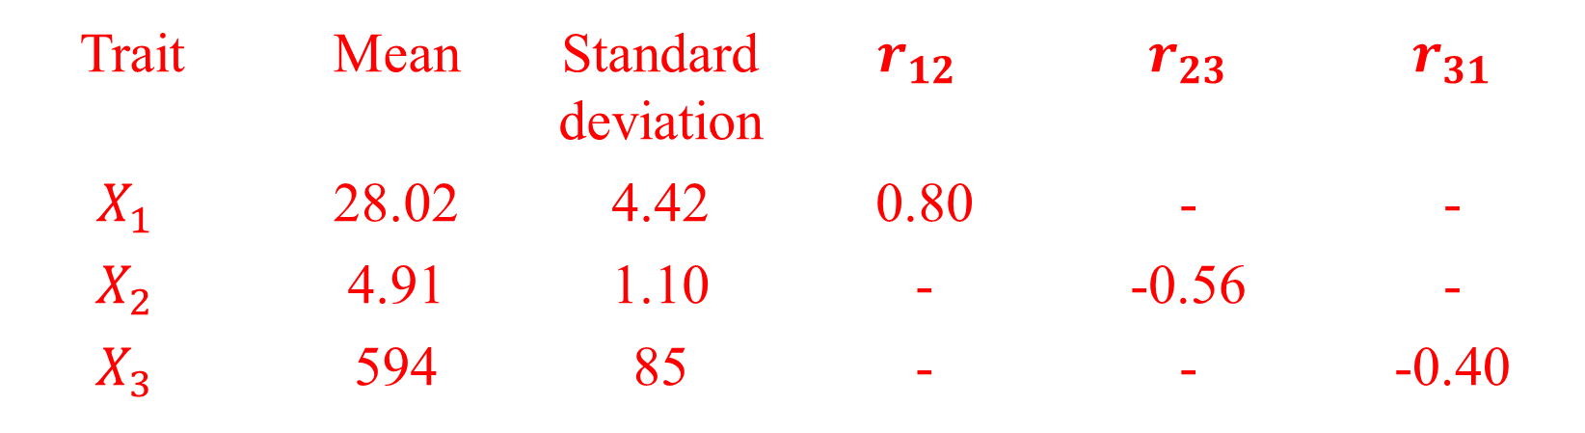
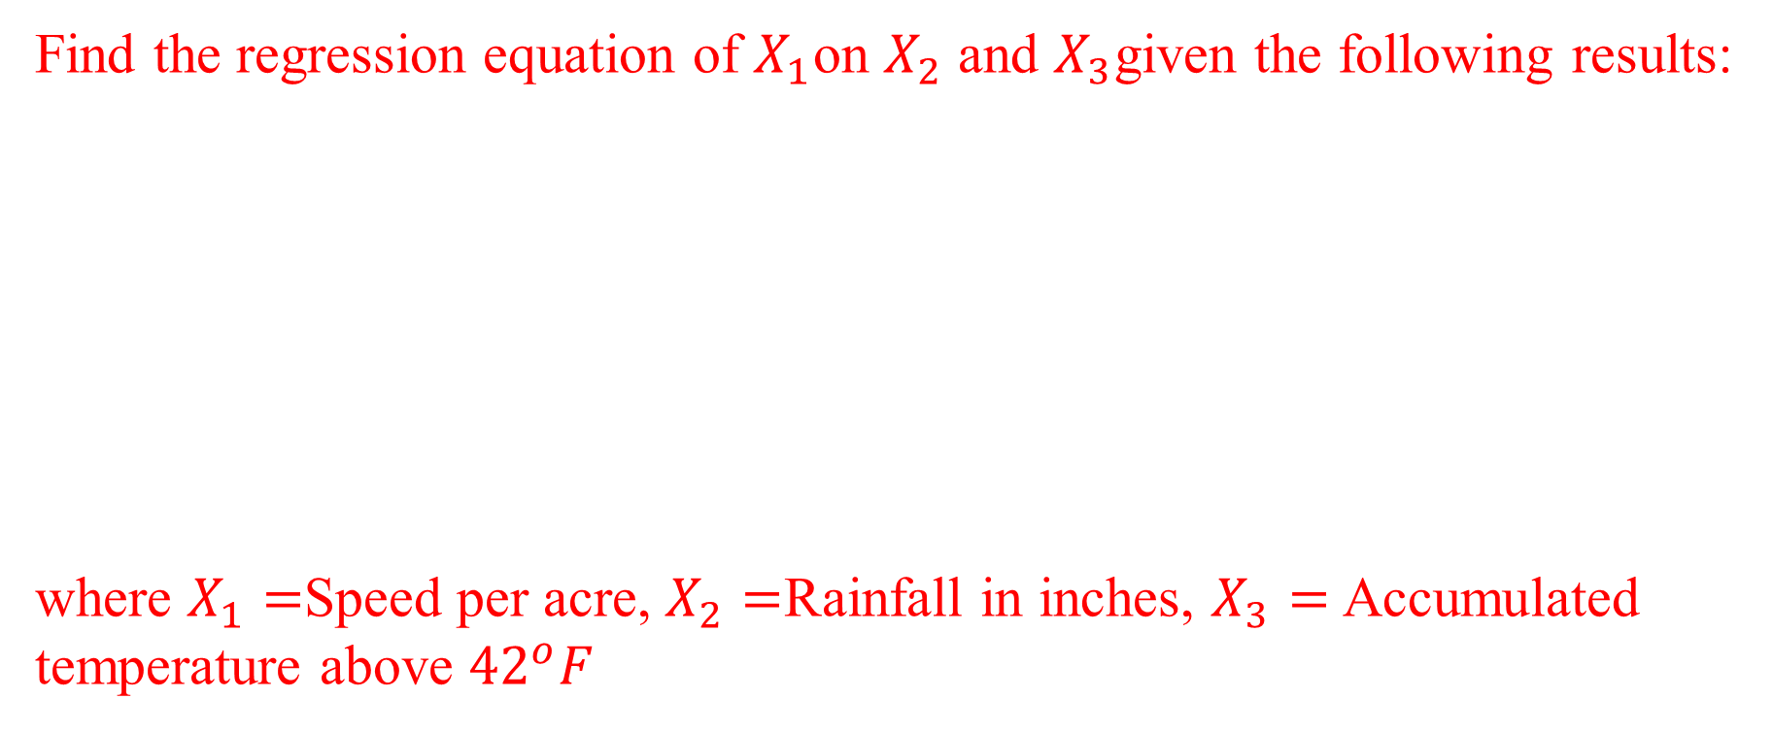
Find the regression equation of $X_{1}$on $X_{2}$ and $X_{3}$given the following results:
where $X_{1}=$Speed per acre, $X_{2}=$Rainfall in inches, $X_{3}=$Accumulated temperature above ${42}^{o}F$
Trait | Mean | Standard deviation | $$r_{12}$$ | $$r_{23}$$ | $$r_{31}$$
$$X_{1}$$ | 28.02 | 4.42 | 0.80 | - | -
$$X_{2}$$ | 4.91 | 1.10 | - | -0.56 | -
$$X_{3}$$ | 594 | 85 | - | - | -0.40

Slide 49
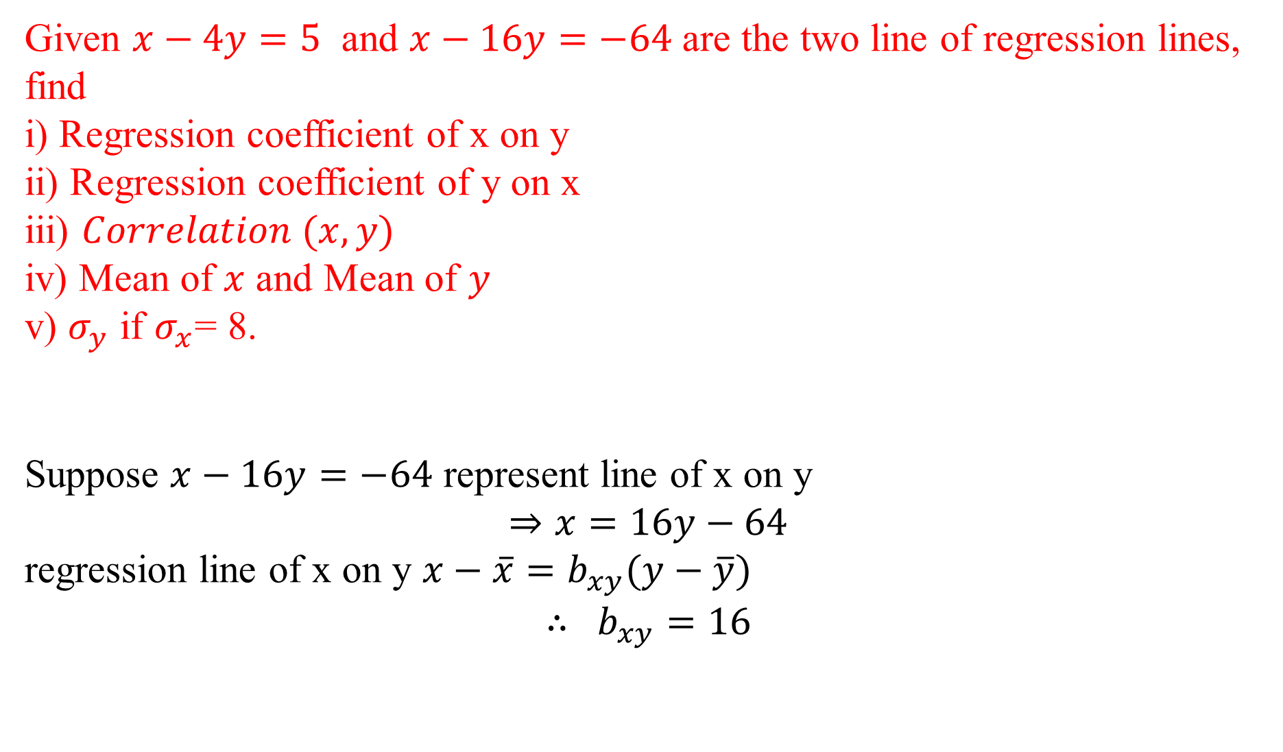
Given $x−4y=5$ and $x−16y=−64$ are the two line of regression lines, find
i) Regression coefficient of x on y
ii) Regression coefficient of y on x
iii) $Correlation (x,y)$
iv) Mean of $x$ and Mean of $y$
v) $σ_{y}$ if $σ_{x}$= 8.
Suppose $x−16y=−64$ represent line of x on y
$$⇒x=16y−64$$
regression line of x on y $x−\overline{x}=b_{xy}(y−\overline{y})$
$$∴ b_{xy}=16$$

Slide 50
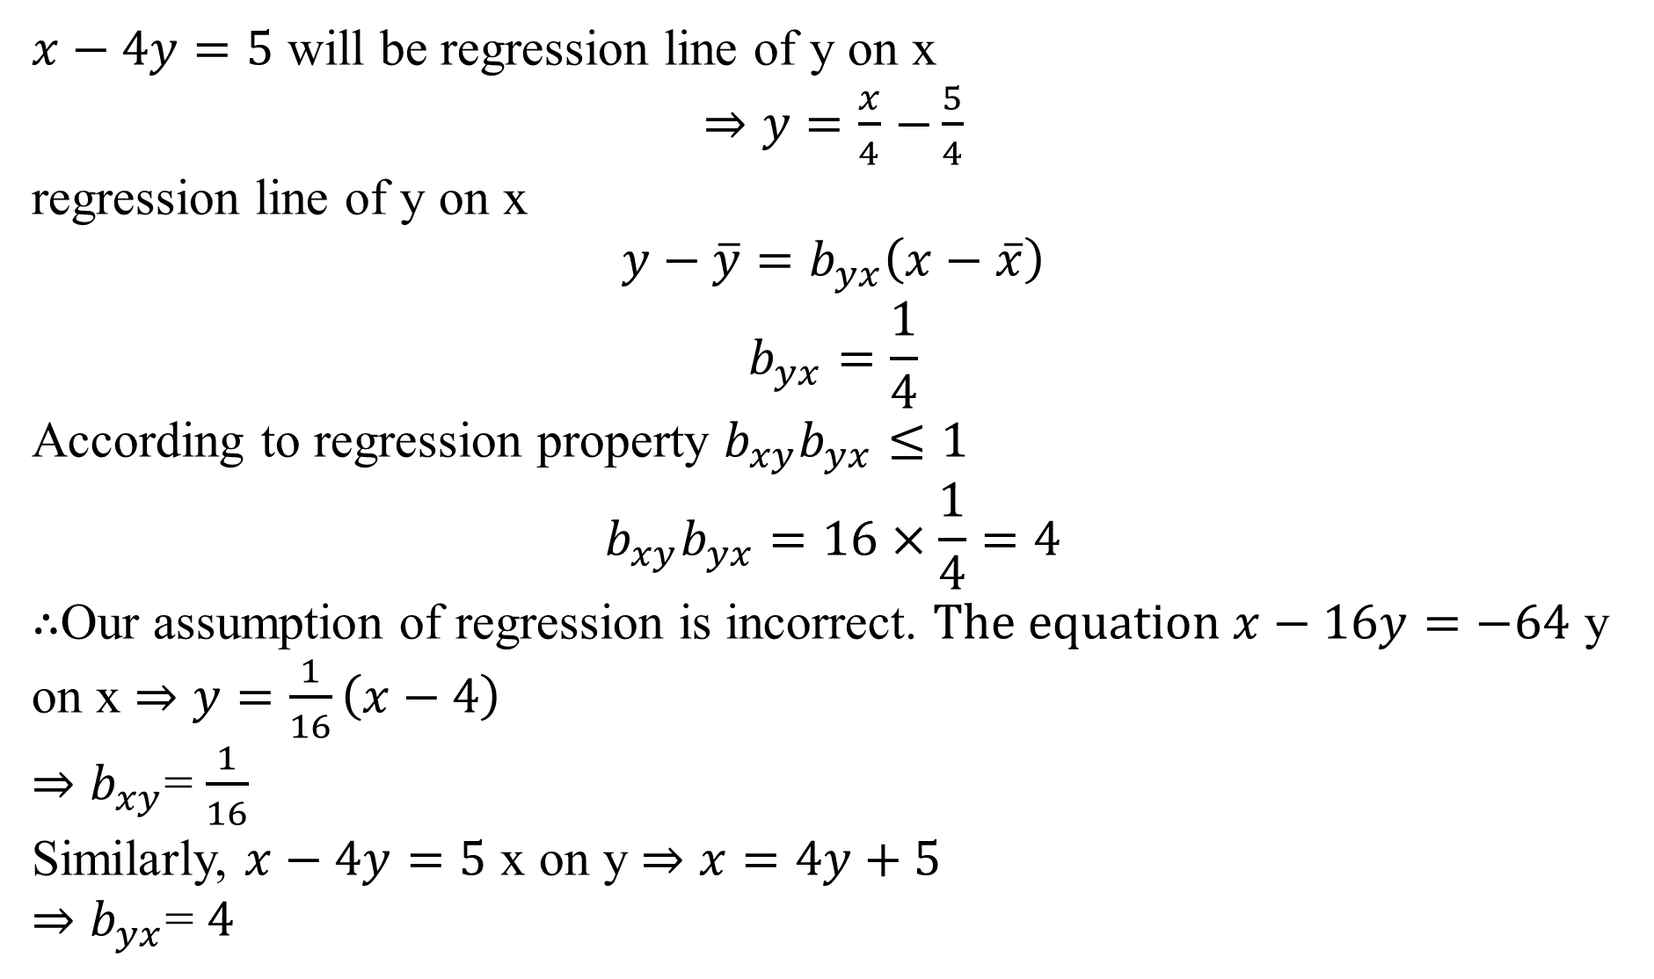
$x−4y=5$ will be regression line of y on x
$⇒y=\frac{x}{4}$ $−\frac{5}{4}$
regression line of y on x
$$y−\overline{y}=b_{yx}\left(x−\overline{x}\right)$$
$$b_{yx}=\frac{1}{4}$$
According to regression property $b_{xy}b_{yx}≤1$
$$b_{xy}b_{yx}=16×\frac{1}{4}=4$$
$∴$Our assumption of regression is incorrect. $The equation x−16y=−64$ y on x $⇒y=\frac{1}{16}\left(x−4\right)$
$⇒$ $b_{xy}$= $\frac{1}{16}$
Similarly, $x−4y=5$ x on y $⇒x=4y+5$
$⇒$ $b_{yx}$= $4$

Slide 51

$$r=\sqrt{\frac{1}{16}×4}=\frac{1}{2}=0.5$$
$$\overline{x}−4 \overline{y}=5$$
$$\overline{x}−16 \overline{y}=−64$$
$$\overline{x}=28, \overline{y}=\frac{23}{4}$$
$$b_{xy}=\frac{rσ_{x}}{σ_{y}}=0.5×\frac{8}{σ_{y}}$$
$$σ_{y}=1$$

